Slide 1
SUSTAINABLE PALM OIL
COALITION FOR INDIA
AN INTRODUCTION

Slide 2
WHY PALM OIL?
Most commonly cultivated vegetable oil in the world
Is a key constituent of most daily consumable products
Over 13% of geographical area of Malaysia and 6% in Indonesia are under palm oil plantations¹
Cultivation of palm oil is associated with significant environmental and social issues such as
Deforestation
Destruction of species habitat
Violation of human rights
Source: Malaysian Palm Oil Board; Indonesia Investments

Slide 3
TYPICAL PRODUCTS CONTAINING PALM OIL
Cooking oil
Pizza dough
Instant noodles
Shampoo
Ice cream
Lipsticks
Detergents
Chocolate
Soap
Packaged bread
Cookies

Slide 4
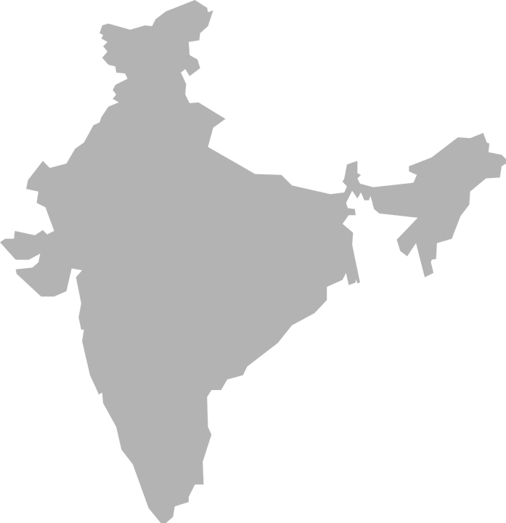
PALM OIL CONSUMPTION
IN INDIA
Domestic consumption – 9.43 Million tones in 2020
India's domestic production of 200,000 MTs
India is the world’s largest importer of palm oil (As per the Ministry of Commerce database, the quantity of palm oil imported in 2019 was 9.75 Million tones; valued at 5,422 Million USD)
Source: Ministry of Commerce and Industry

Slide 5
SECTORAL CONSUMPTION
Source: TransGraph

Slide 6
WE ARE
PRIMARY MEMBERS
Business-led, multi-stakeholder sustainability initiative
Promoting sustainable sourcing, trade and consumption of palm oil and its derivatives along the supply chain
Supported by global standards and leading sustainability organisations and businesses
WE BUILD
01
Multisector industrial dialogue on sustainable palm oil
Sustainable trade partnerships that discuss challenges & opportunities (principle of ‘shared responsibility’)
Dialogue for supportive policy, regulatory environment
Capacity on sustainable sourcing strategies and actions
AFFILIATED MEMBER
STEERING COMMITTEE
02
SECRETARIAT

Slide 7
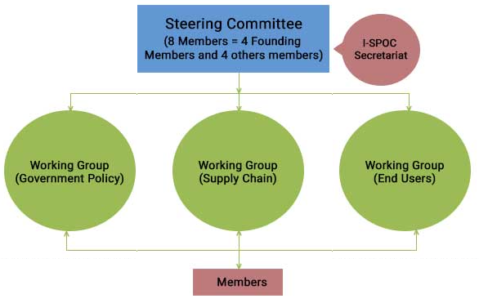
GOVERNANCE STRUCTURE

Slide 8
WORKING GROUPS
GOVERNMENT POLICY
SUPPLY CHAIN
END USERS

Slide 9
OUR JOURNEY SO FAR….
2018
I-SPOC was launched in Delhi
2019
First Members’ Meeting in Mumbai
SEPTEMBER
MAY

Slide 10
OUR JOURNEY SO FAR….
2019
I-SPOC completes one year
2019
Second Members’ Meeting in Delhi
SEPTEMBER
NOVEMBER

Slide 11
OUR JOURNEY SO FAR….
2019
CEOs Panel on Sustainable Palm Oil
2020
Third Members’ Meeting
NOVEMBER
APRIL

Slide 12
OUR JOURNEY SO FAR….
2020
I-SPOC Celebrated 2 Years
SEPTEMBER

Slide 15
JOIN I-SPOC
COMMIT TO SUSTAINABLE PALM OIL
Be Part Of The Movement To Promote Dialogue & Actions Towards Sustainable Palm Oil In India
India continues to be the largest consuming market for palm oil and in the unique position to drive responsible sourcing globally.
I-SPOC convenes a unique platform bringing together the front-runners of global sustainability, important national stakeholders (refiners, processors, traders and producers) in palm oil value chain and other ecosystem actors (civil society, financial sector and government agencies)

Slide 16
TO BECOME A MEMBER YOU MUST
Be a committed stakeholder in the palm oil supply chain in India
Have an interest in the uptake of responsible sourcing practices
Be inspired to make an Institutional commitment or strategy on Sustainability/Sustainable Sourcing/SDGs
Believe in the principle ‘shared responsibility’

Slide 17
For further information, please contact
Bhavya Sharma, bhavya@c4rb.in

